Slide 1
CAR Administrator Calibration Meeting - CAR Review -
February 26 2013
Team A: Paul Ip, Thomas Kestner, Balina Ling, Kila Yang

Slide 2
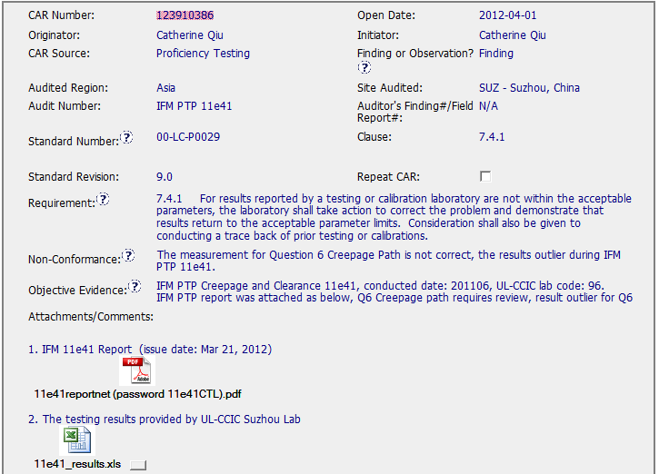
CAR No. 123910386

Slide 3
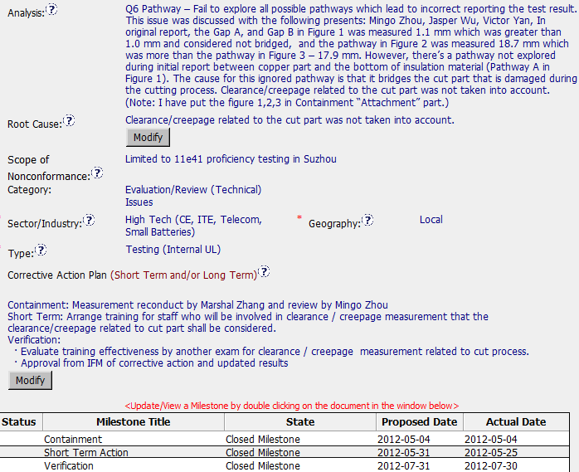
CAR No. 123910386
The analysis is clear to describe why the non-conformance was happened, and the stakeholders were involved in this analysis. And also has clear path to determine the root cause.
However, the analysis did not state how widespread this problem is. Therefore, how to determine the scope of NC was limited to this PTP only?
Containment / Short Term Action / Verification included in this Finding CAR

Slide 4
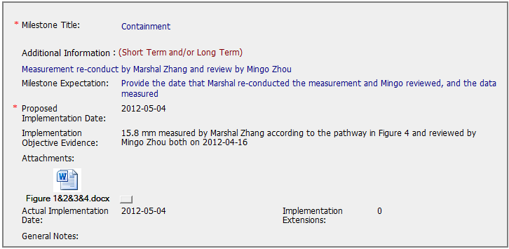
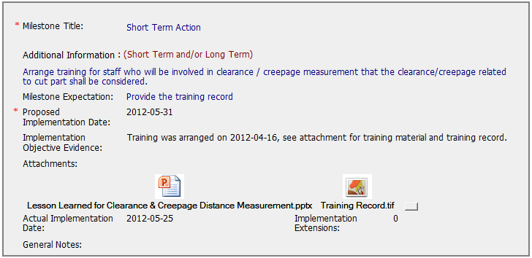
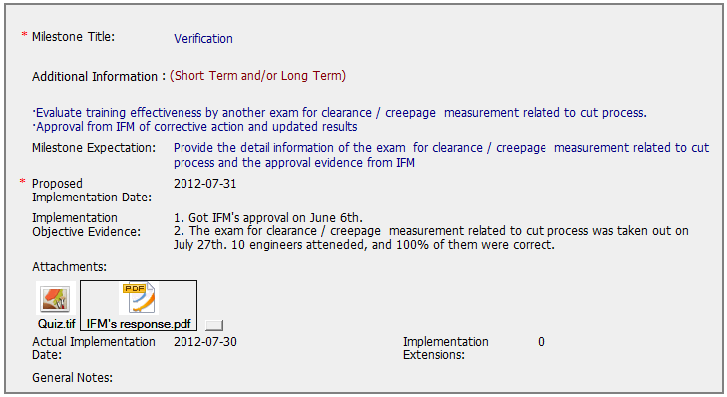
CAR No. 123910386
The implementation of corrective action had met the milestone expectations in each phases.

Slide 5
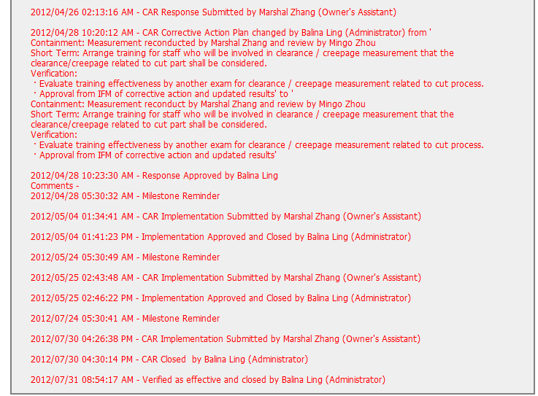
CAR No. 123910386
CAR Admin has approved in a timely manner when CAR Owner submitted the response/implementation

Slide 6
Q1 2013 CAR Analysis
Team:
Bill Konigsfeld
Alan Purvey
Jenni Murrill

Slide 7
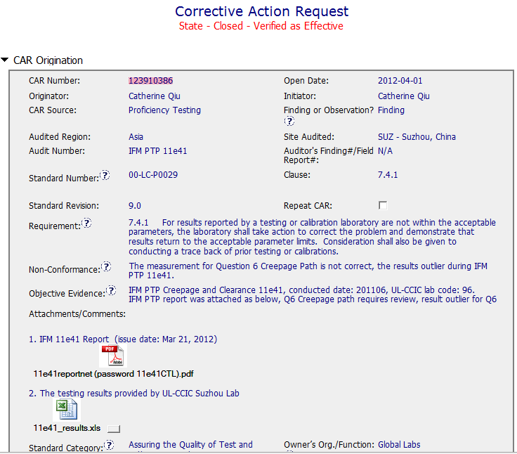
Finding
Suitable information appears to be properly stated in the Requirement, NCR, and Obj. Evidence
OFI: Identify response due date to IFM.
Original IFM Report and test data included for background information.

Slide 8
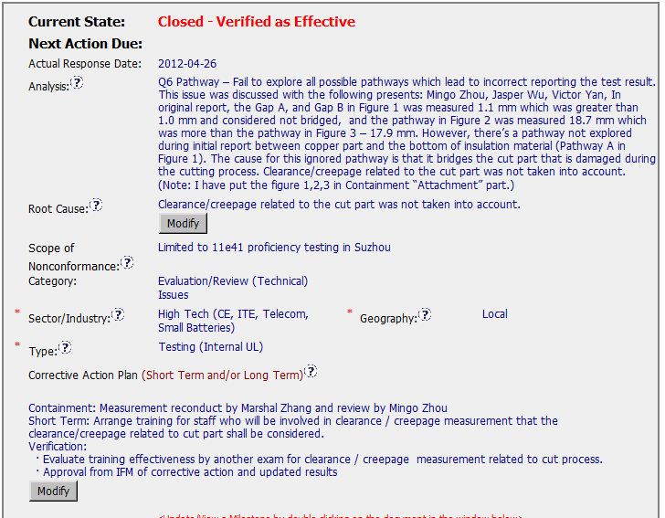
Finding :123910386
Analysis: Includes stakeholders but not role in analysis. Good explanation of what measurement was missed and why.
CAP: Appropriately addresses short term and long term actions.

Slide 9
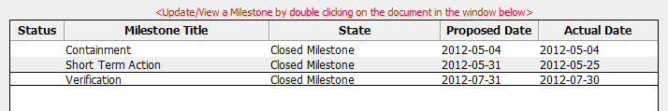
Finding 123910386
Records of the re-measurement submittal to IFM, Record of Training/participants, record of reevaluation of staff, record of acceptance from IFM are contained in milestones.
OFI: Comment from IFM in verification:
“ I would just comment that although the sectioning of the sample would undoubtedly have contributed to the failure to explore all pathways, an equivalent pathway on the side of the contact not sectioned would still have been intact, but this was also missed.
Nevertheless, the CAR is accepted and I confirm that this completes the follow- up action with IFM.”
Owner could have addressed the alternate missed element by reconducting training or at a minimum informing staff.
Best Practices?:
The verification milestone includes a record of a quiz (C&C exercise) to determine effectiveness of training. All participants passed.

